Slide 1
Università di Camerino
Hadoop-based data analysis platform
for e-commerce websites
Subject:Technologies for Big Data Management
Professor:Massimo Callisto De Donato
Group member:GU Yuzhan
Guo Yushan
Ma Deyuan

Slide 2
CONTENTS
01
Background
02
03
04
05
Environmental Description
Data Cleaning
Demand Analysis
Show&Visualisation

Slide 3
01
BACKGROUND

Slide 4

01 Background
Why We Choose Hadoop？
scalability
computing performance
robustness
low cost

Slide 5
HOW ABOUT E-COMMERCE?

Slide 6

01 Background

Slide 7
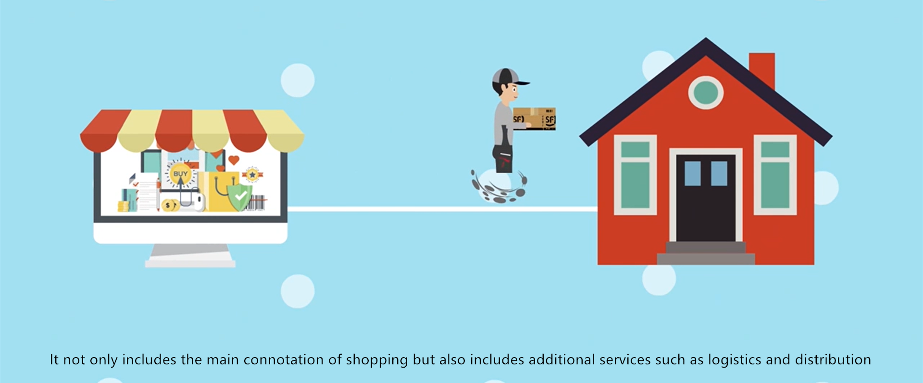

Slide 8
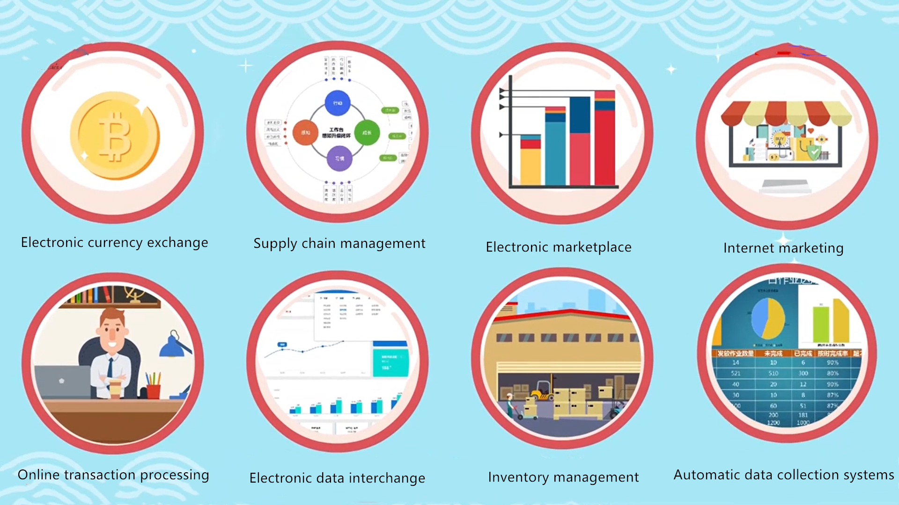

Slide 9


Slide 10
02
Demand Analysis

Slide 11


02 Demand Analysis
“
Due to the limitations of traditional data analysis on single-machine systems, when processing large amounts of data, it will significantly affect system performance.Therefore, in order to solve this problem, this project proposes a Hadoop-based e-commerce website data analysis system solution based on the in-depth analysis of Hadoop big data platform related technologies to help enterprises use effective data analysis methods to make better business decisions.
”

Slide 12
03
Environmental description

Slide 13
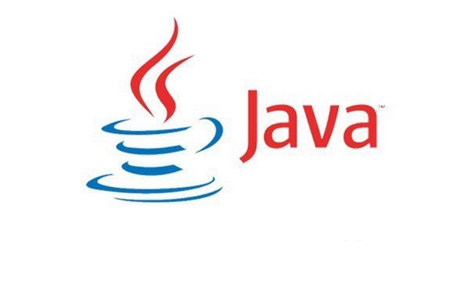


03 Environmental description
Java version:1.8
Scala version:2.11.12
Hadoop version:hadoop-2.7.5
Java is a programming language that is intentionally designed for use in the distributed environment of the Internet.。
Scala, short for Scalable Language, is a multi-paradigm programming language
Hadoop is a distributed systems infrastructure developed by the Apache Foundation, a software framework for storage system + computing framework

Slide 14



03 Environmental description
spark version:spark-2.3.1
MySQL version:5.7.22
zeppelin version:0.10.1
Spark is a fast, versatile, and scalable big data analytics engine
MySQL is a relational database management system that keeps data in different tables instead of putting all the data in one big warehouse, which increases speed and flexibility.
Zeppelin is a web-based notebook that provides interactive data analysis and visualization

Slide 15
04
Data Cleaning

Slide 16
04 Data Cleaning
Data cleansing
According to the requirements, parse the information we need from the logs, such as :
1. System properties accessed: operating system, browser, etc
2. Access characteristics: URL, referer (from which URL it jumped), dwell time on the site, etc
3. Access information: access IP, longitude, latitude, etc

Slide 17
04 Data Cleaning
Main program
The first step of SparkStatFormatJob.scala is to cleans up various fields like ip, time, file system, coordinates, and more.
The second step of SparkStatCleanJob.scala is the final cleaning conversion ip, time, url, code, traffic, brower, day
AccessConvertUtil.scala defines a DataFrame schema, which converts log information into objects and helps RDDs turn into DataFrames

Slide 18
04 Data Cleaning
steps
1. Use Spark to parse access logs, clean and upload them to HDFS
2. Read the file in HDFS, perform secondary cleaning, and write the results to HDFS as parquet
3. Use Spark to partition the access time by day

Slide 19
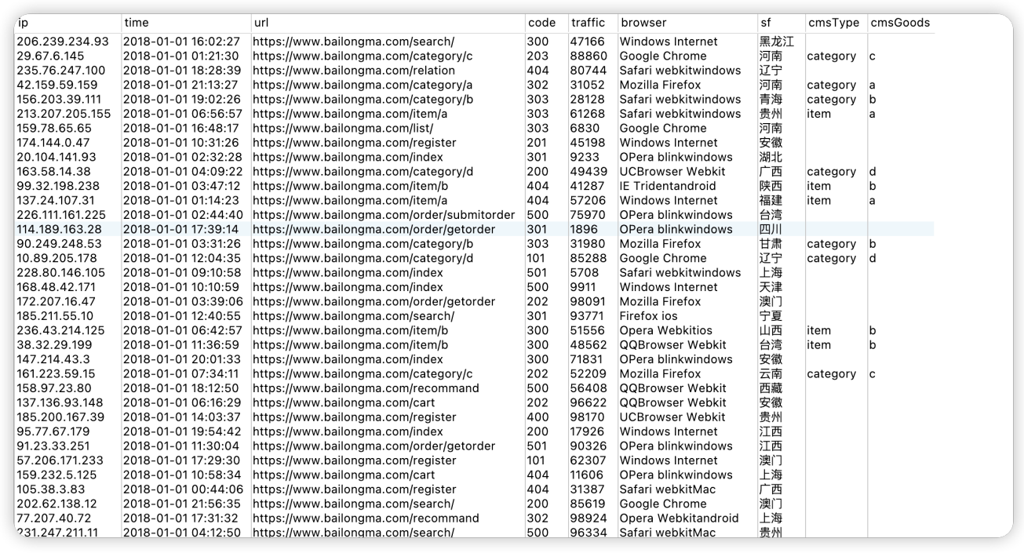
04 Data Cleaning

Slide 20
05
Show&Visualisation

Slide 21
05 Show&Visualisation
5.1 Software interface display
5.2 Visualisation of statistical results

Slide 22
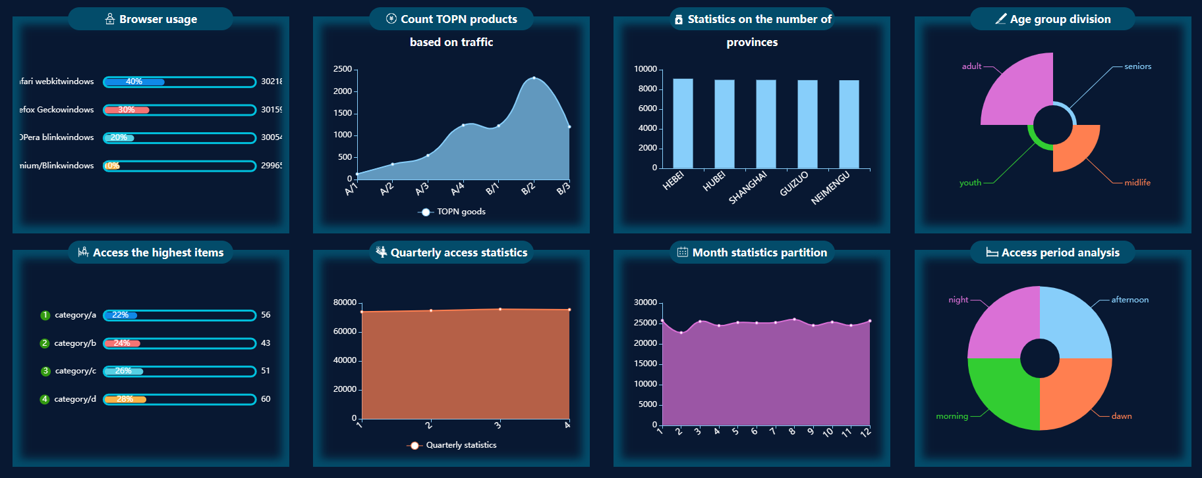
5.1 Software interface display

Slide 23
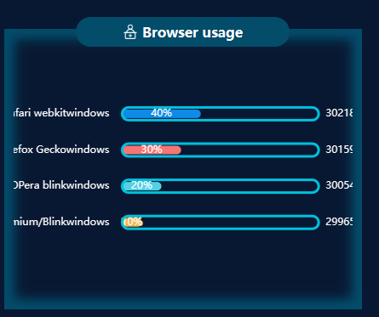
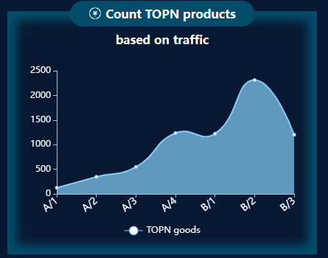
5.2 Visualisation of statistical results
Browser usage
Count TOPN products

Slide 24
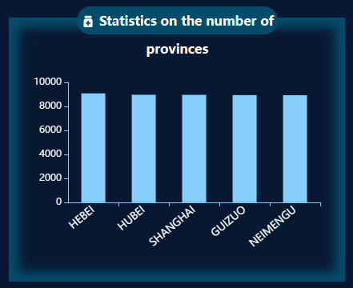
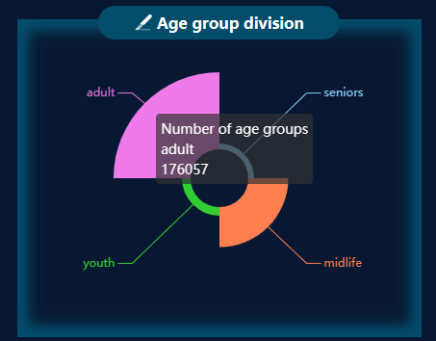
5.2 Visualisation of statistical results
Statistics on the number of provinces
Age group division

Slide 25
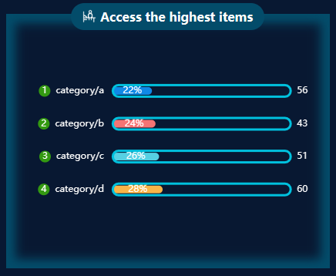
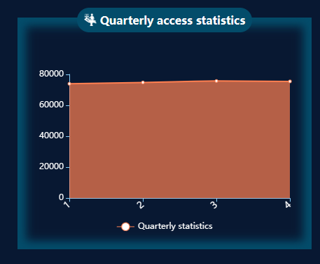
5.2 Visualisation of statistical results
Access the highest items
Quarterly access statistics

Slide 26
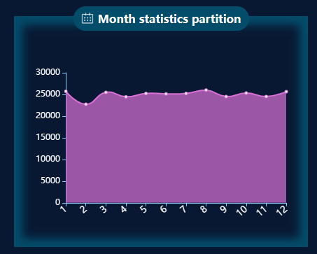
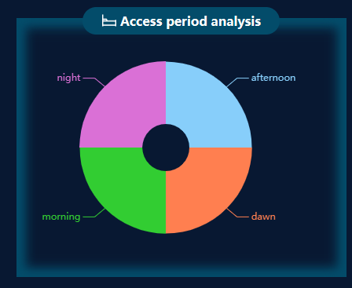
5.2 Visualisation of statistical results
Month statistics partition
Access period analysis

Slide 27
Università di Camerino
THANK YOU FOR LISTENING

